Slide 1
Predicting customer buying behaviour
Using random Forest to predict that customer completes the booking

Slide 2
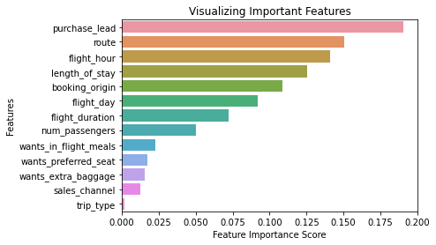
Feature Importance:
As per the shown figure, The most important feature that has an impact of the customer behavior to complete the booking is the purchase lead which is the time between making the booking to the day of booking.
Additionally other features like ,’route', 'flight hour', 'length of stay’ ,’booking origin’ and ‘flight day’.
The model prediction accuracy is 85% and it can be indication of making use of the mentioned features like making promotional offers or some discounts related to the lead time or booking origin country.

